Slide 1
Secure Your Cloud with Confidence
Defend against Threats with Microsoft Sentinel
David Branscome
dabran@microsoft.com

Slide 2
Agenda
Ingest Syslog and CEF logs to Microsoft Sentinel
MSSP and Azure Lighthouse
Basic and Analytics Log Ingestion, Search, Archiving and Data Restoration
Watchlists
Analytics Rules

Slide 3
Ingest Syslog and CEF logs to Microsoft Sentinel

Slide 4


CEF and Syslog
Syslog is both a logging format AND a transport protocol
CEF is a structured format and schema delivered over the syslog transport protocol
CEF data is parsed. Syslog messages require query time parsing.
When you have the option, use CEF
<134> 2018-02-21T16:15:00-04:00 PulseSecure: 2018-02-21 16:15:00 - ive - [127.0.0.1] fakeuser(Admin Users)[] - Primary authentication successful
for fakeuser/Administrators from 127.0.0.1
<134> Dec 06 16:51:38 hostname CEF:0|JATP|Cortex|3.6.0.1444|email|Phishing|8|externalId=1504 eventId=14067 lastActivityTime=2016-12-06 23:51:38+00 src= dst= src_hostname= dst_hostname= src_username= dst_username=src_email_id=src@abc.comdst_email_id={test@abc.com} startTime=2016-12- 06 23:51:38+00 url=http://greatfilesarey.asia/QA/files_to_pcaps/74280968a4917da52b5555351eeda969.bin
fileHash=bce00351cfc559afec5beb90ea387b03788e4af5 fileType=PE32 executable (GUI) Intel 80386, for MS Windows

Slide 5
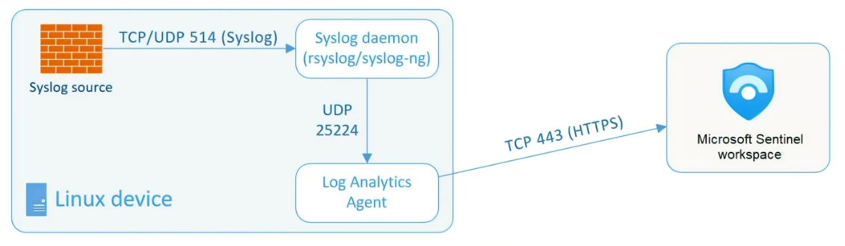
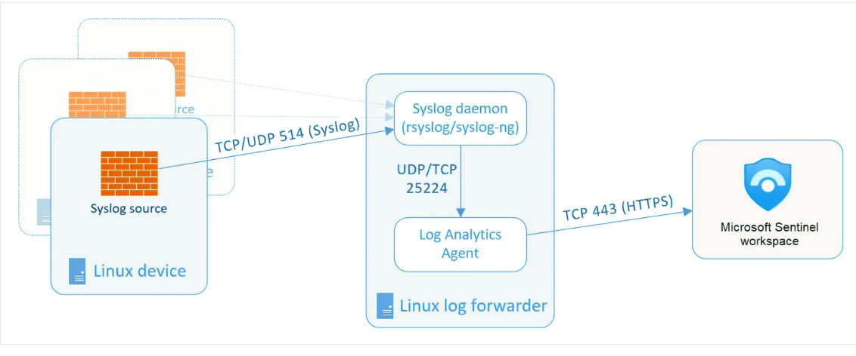
Use a log forwarder to ingest Syslog and CEF logs to Microsoft Sentinel
Typically used when a device or appliance does not support installation of Log Analytics agent
Linux machine configured with:
  Syslog daemon
  Log Analytics agent
Forwards logs to Sentinel workspace
Can be set up behind load balancer for higher availability

Slide 6
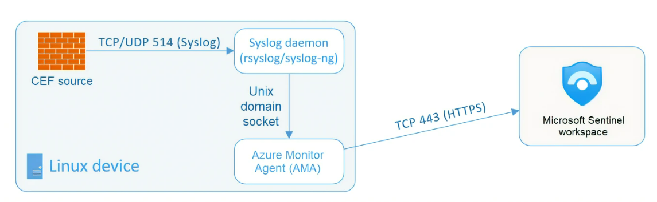
Stream CEF logs with the AMA connector
Similar principle to using the Log Analytics agent on the VM.
Use connector in Sentinel to set up ingest logging using data collection rules

Slide 7
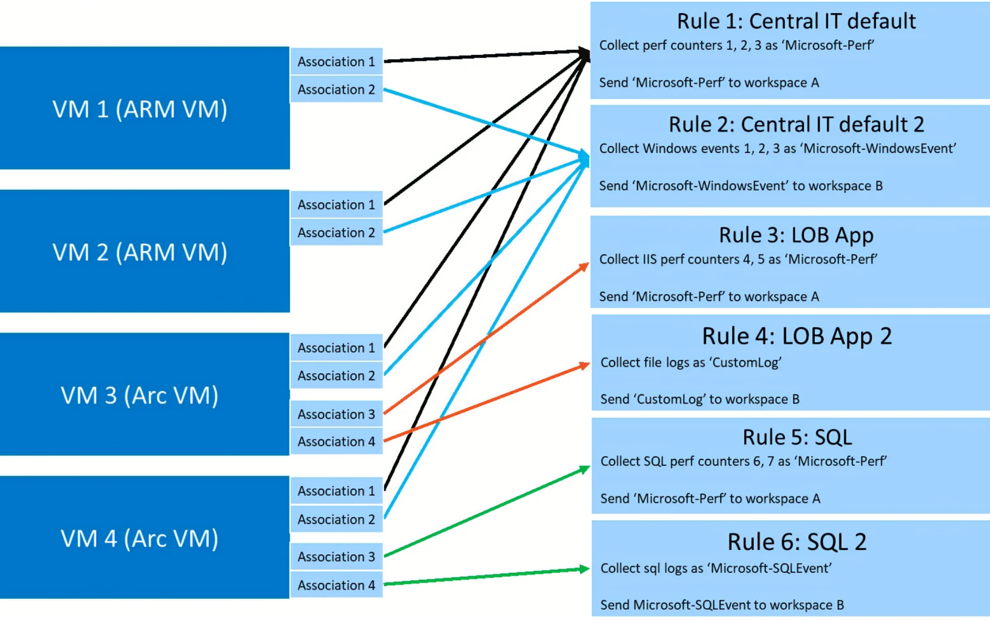
Understanding Data Collection Rules (DCR)
Used to define:
  Data to be collected
  How to transform data
  Where data should be sent
You can configure data collection rules to send different types of data to different workspaces
  e.g., perf data to Azure Monitor and security data to Microsoft Sentinel

Slide 8
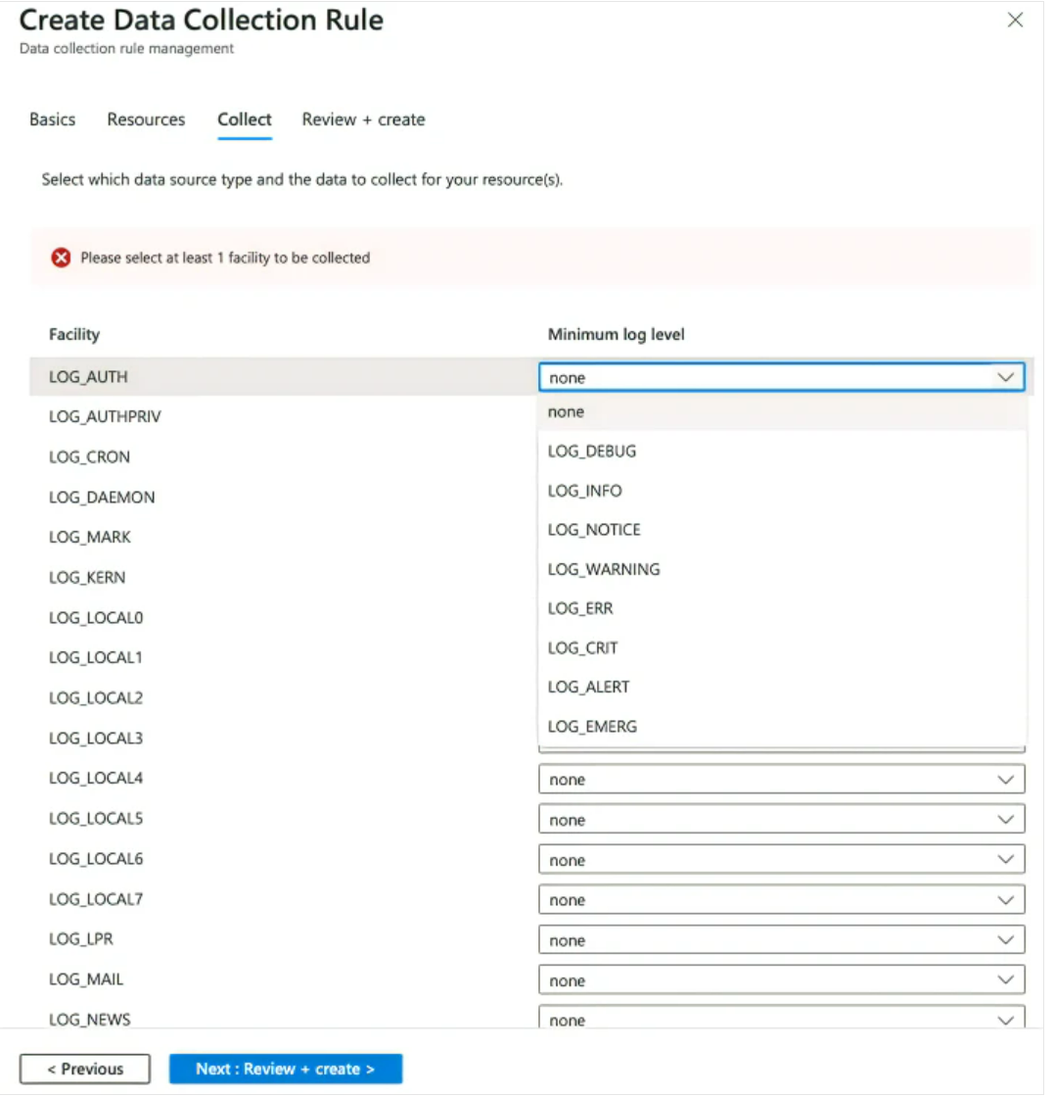
Creating Data Collection Rules in Common Event Format (CEF) via AMA
Set up the CEF via AMA Connector in the Sentinel workspace
Create a DCR in the connector page
Define your target resources (VMs)
Select the data source type and create the DCR
Run installation script on Linux forwarder machine to reconfigure the rsyslog/syslog-ng daemon

Slide 9
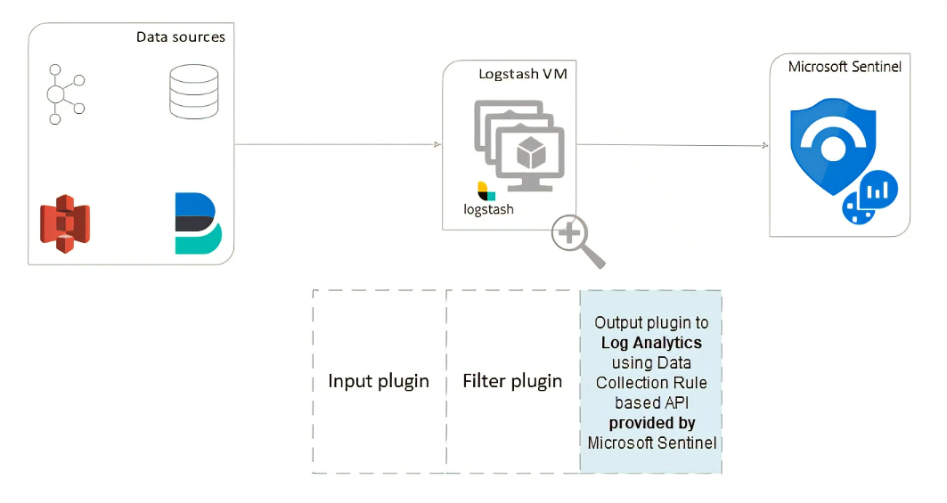
Use Logstash to stream logs with pipeline transformations via Data Collection Rules-based API

Slide 10
DEMO
Data Collection Rules

Slide 11
MSSP and Azure Lighthouse

Slide 12
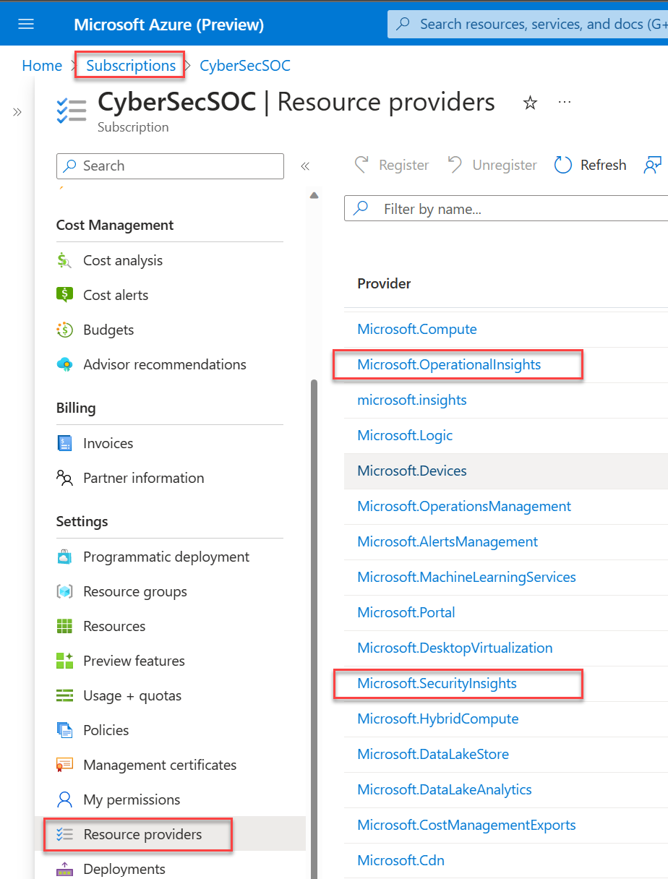
Manage multiple tenants in
Microsoft Sentinel as an MSSP
Register the Microsoft Sentinel resource providers
Onboard each customer subscription using delegated resource mgmt. or Azure Resource Manager template
Use Azure portal, PowerShell, Azure CLI to manage Sentinel workspaces

Slide 13
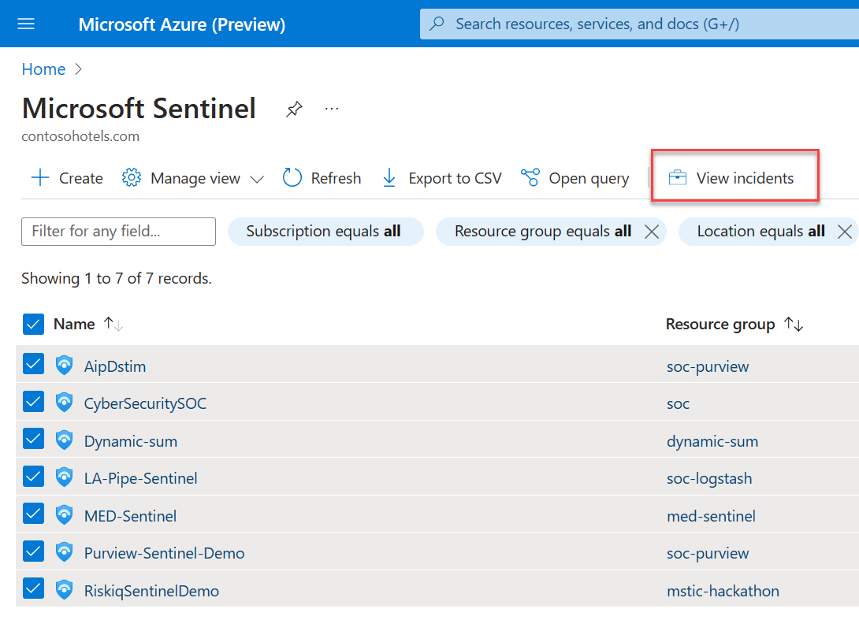
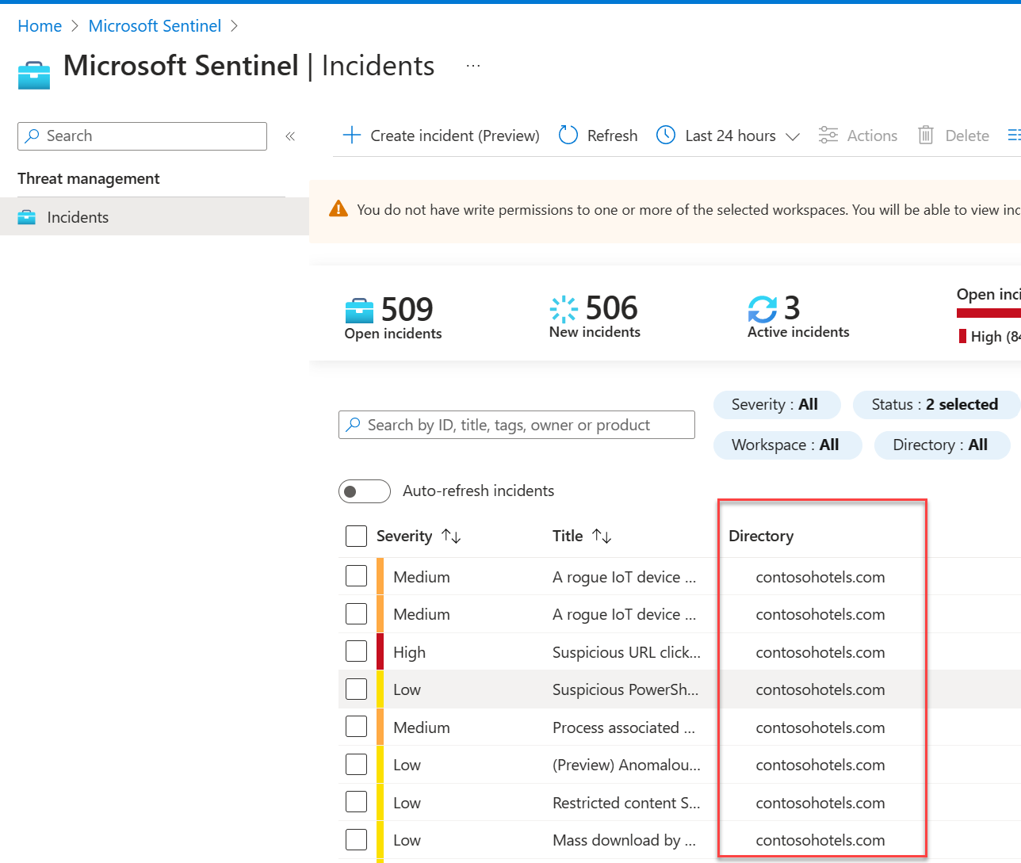
Work with Sentinel incidents in multiple workspaces
Multiple Workspace View displays a maximum of 100 workspaces
Currently only supports viewing of incidents

Slide 14
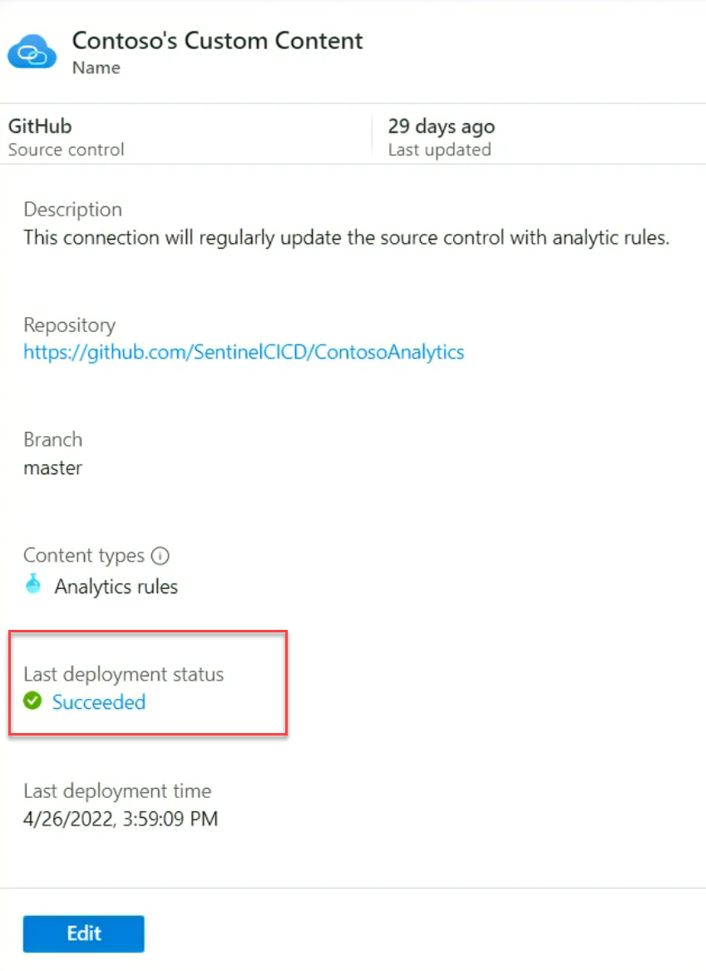
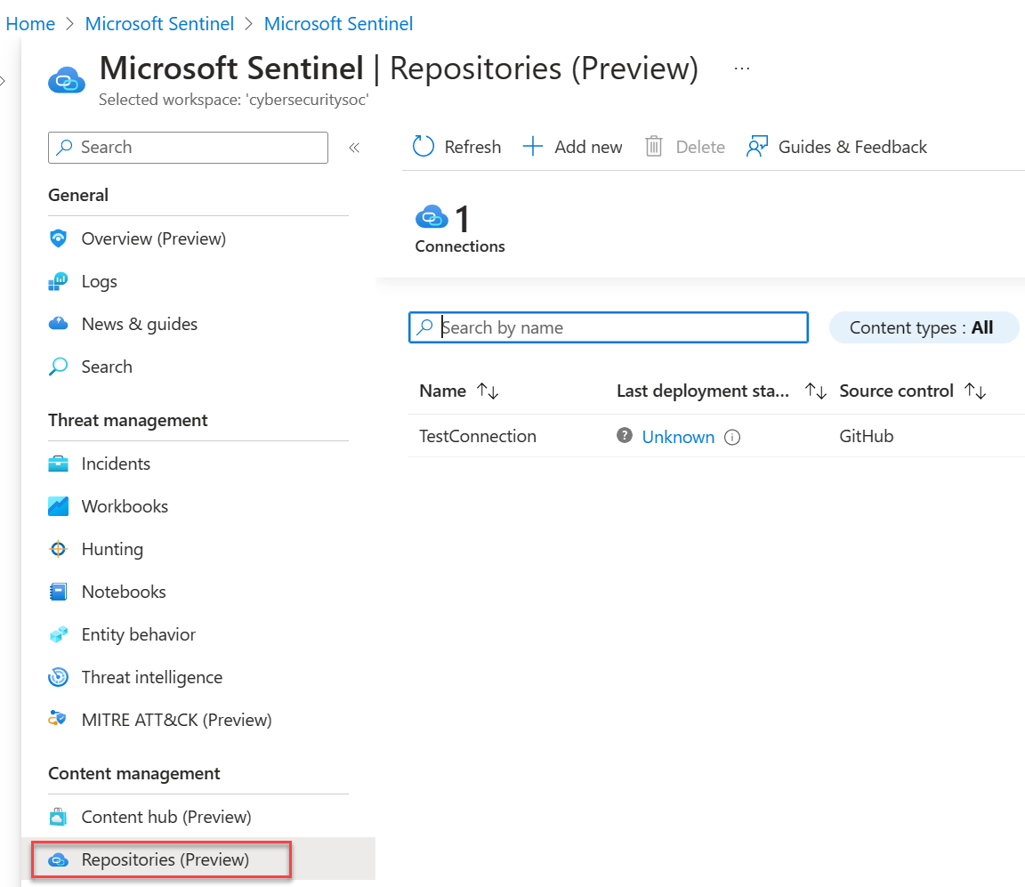
Deploy content centrally using repositories
MSSP creates content to be deployed in GitHub or Azure DevOps
Creates a “source of truth” for all content to be deployed to customers (e.g., analytic rules, automation rules, hunting queries, parsers, etc…)
Stored as ARM template
Covered in more detail in later session

Slide 15
DEMO:
Microsoft Sentinel Lighthouse view
Repositories

Slide 16
Basic and Analytics Log Ingestion,
Search, Archiving and Data Restoration

Slide 17
Basic and Analytics Log Ingestion

Slide 18
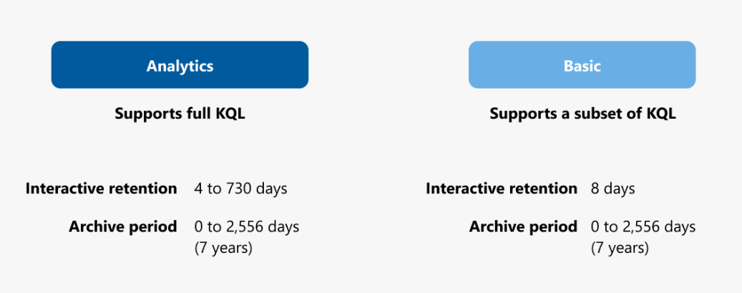
Basic Logs vs. Analytics Logs
Two different log data plans, depending upon logging needs.
Analytics: regular ingestion cost; no cost per-query; longer retention
Basic: reduced ingestion cost; pay-per-query; shorter retention

Slide 19
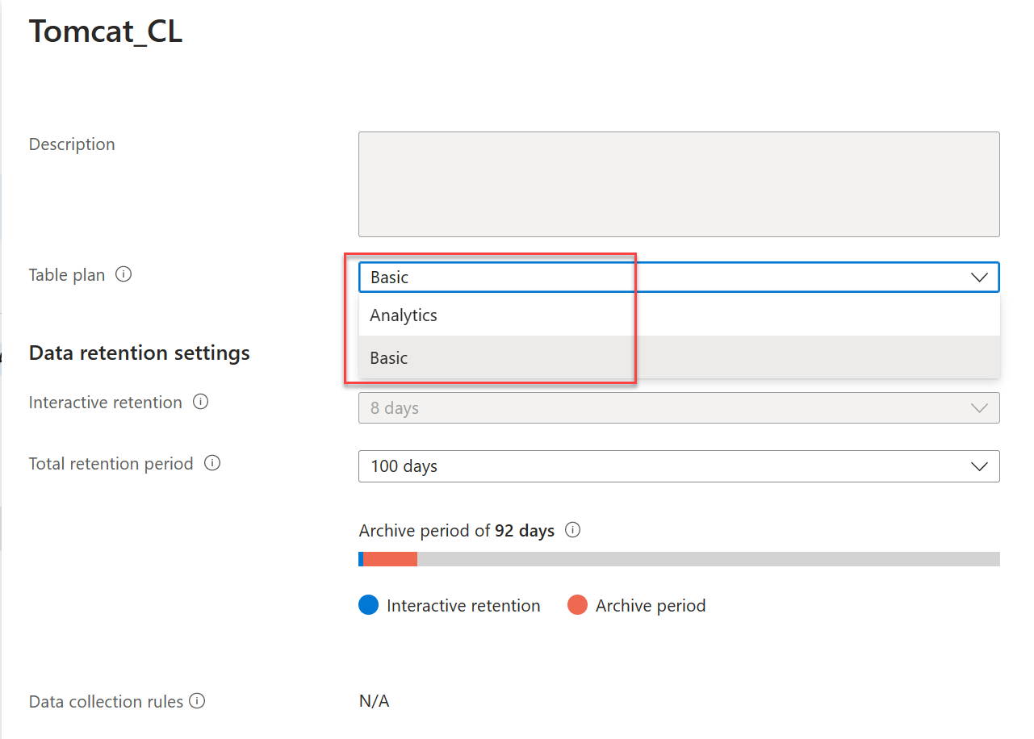
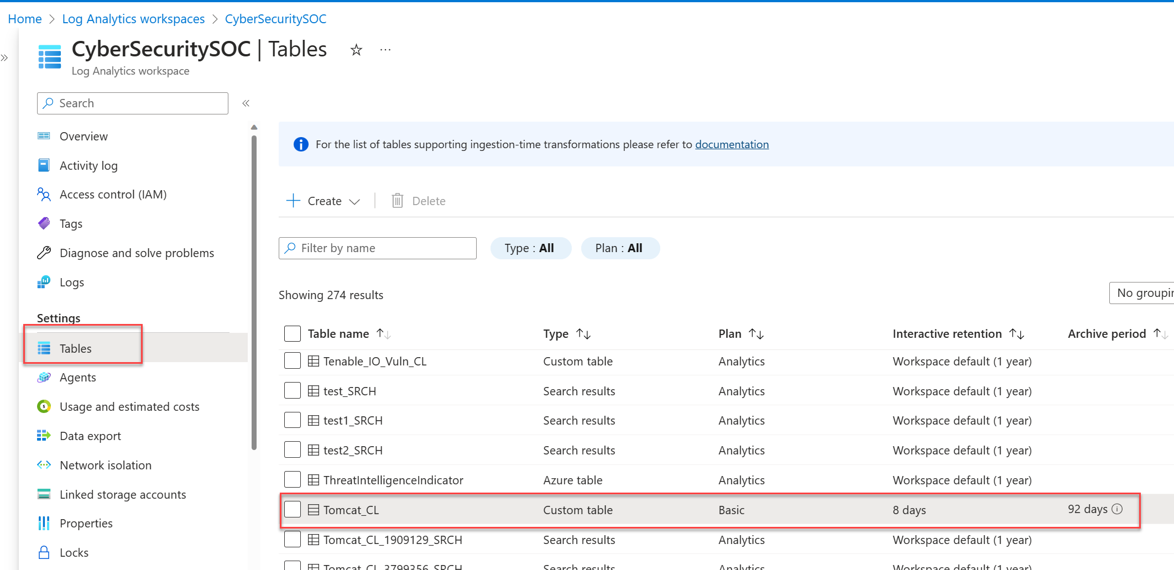
Changing the table plan

Slide 20
Search

Slide 21
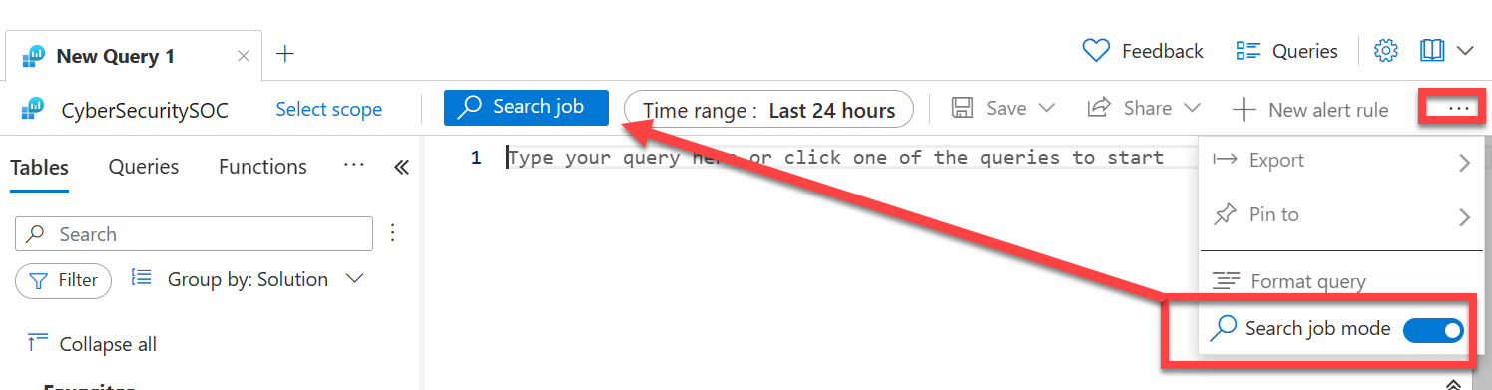
Search jobs in Log Analytics
Search jobs are used to collect records into a new search table for additional analytics
Typically used to process queries in extremely large datasets
Run from Search blade in Sentinel or use “Search job mode” in Log Analytics workspace

Slide 22
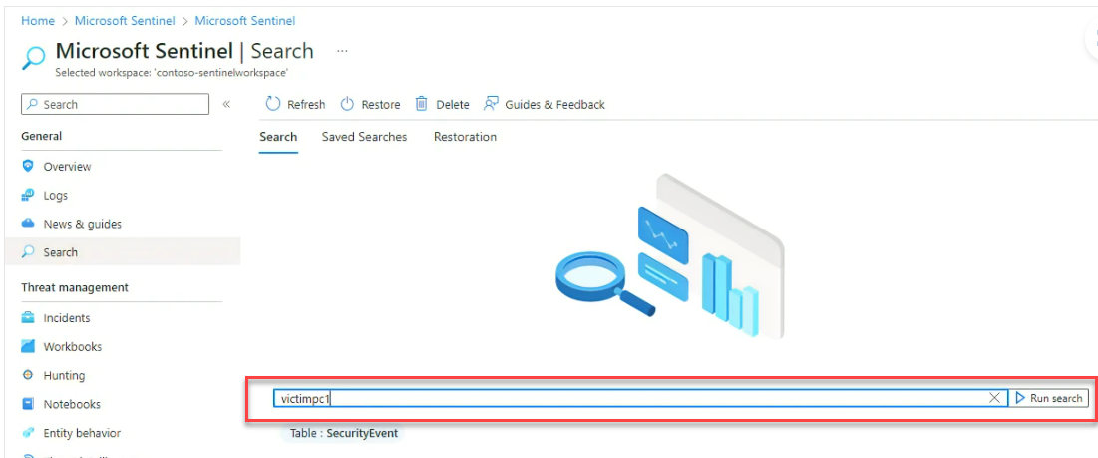
Considerations for Search jobs
Weigh cost-benefits of running a Search job vs. Restore job from a specific time range or paying per-query charges on Basic logs
Running a search job also incurs processing charges, so optimize queries as much as possible
Be aware of the limitations of Search

Slide 23
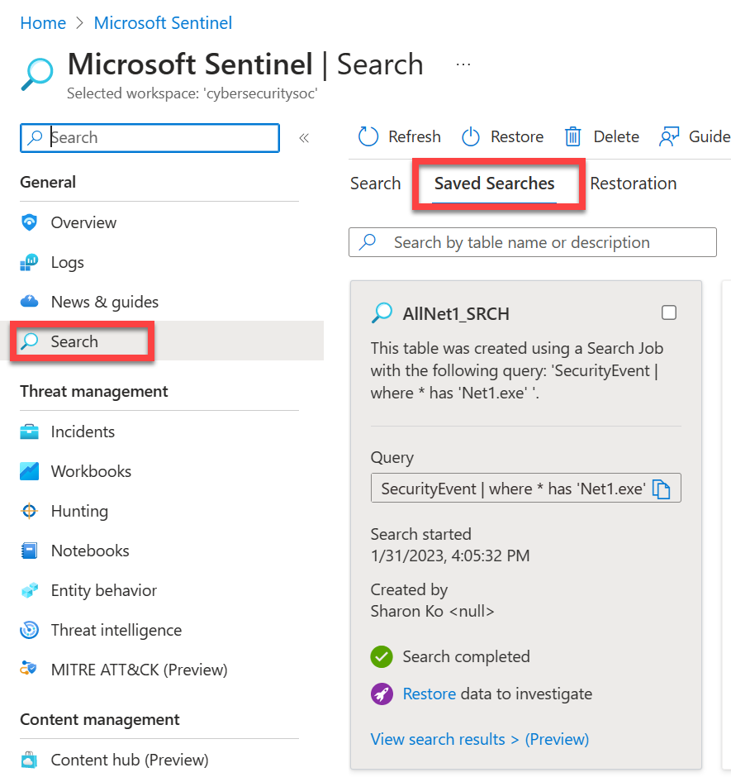
View completed Search jobs in Sentinel
Search results are stored in tables with *_SRCH suffix
Locate search results in Saved Searches tab
View the results of Search query
Delete search results when investigation is complete to reduce costs for storage

Slide 24
DEMO:
Search logs

Slide 25
Archiving and Data Restoration

Slide 26
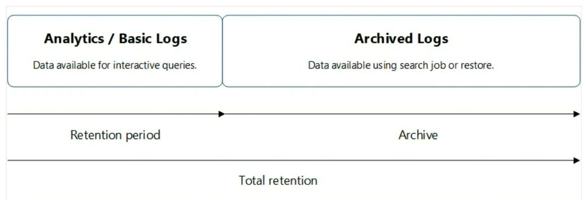
Understanding retention and archiving
Retention policies define when to remove or archive data in a Log Analytics workspace
Archiving lets you keep older, less used data in your workspace at a reduced cost

Slide 27
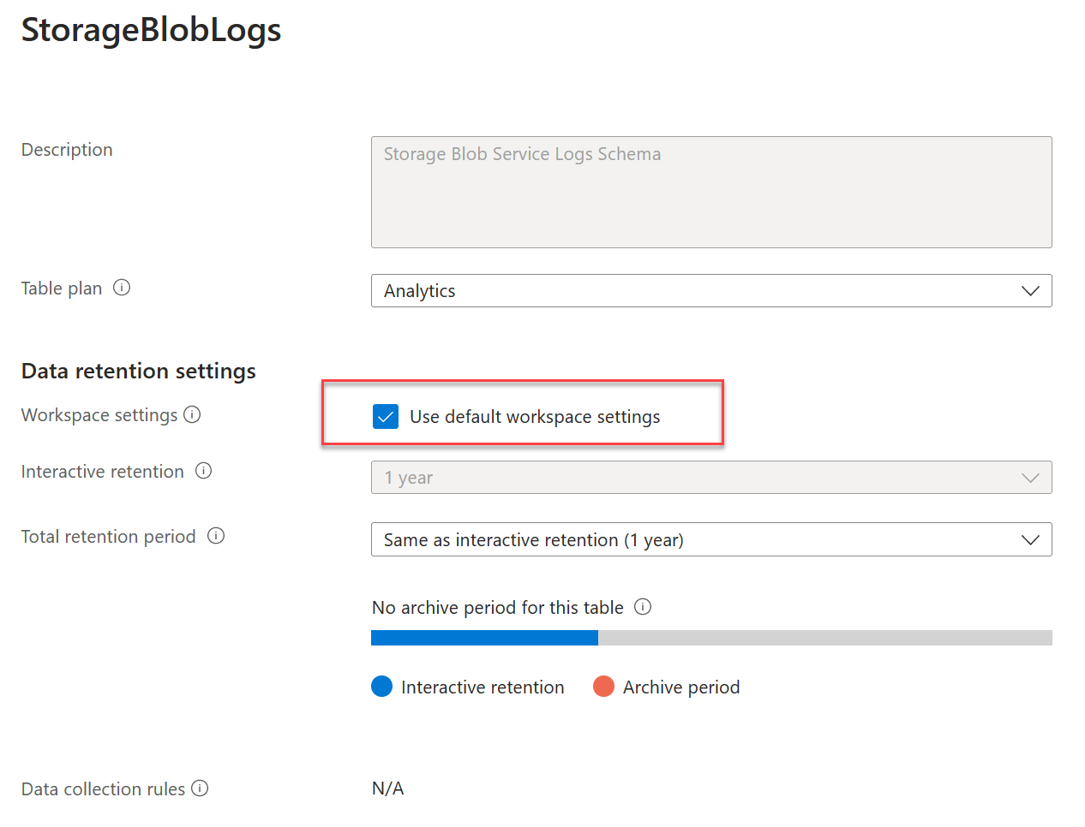
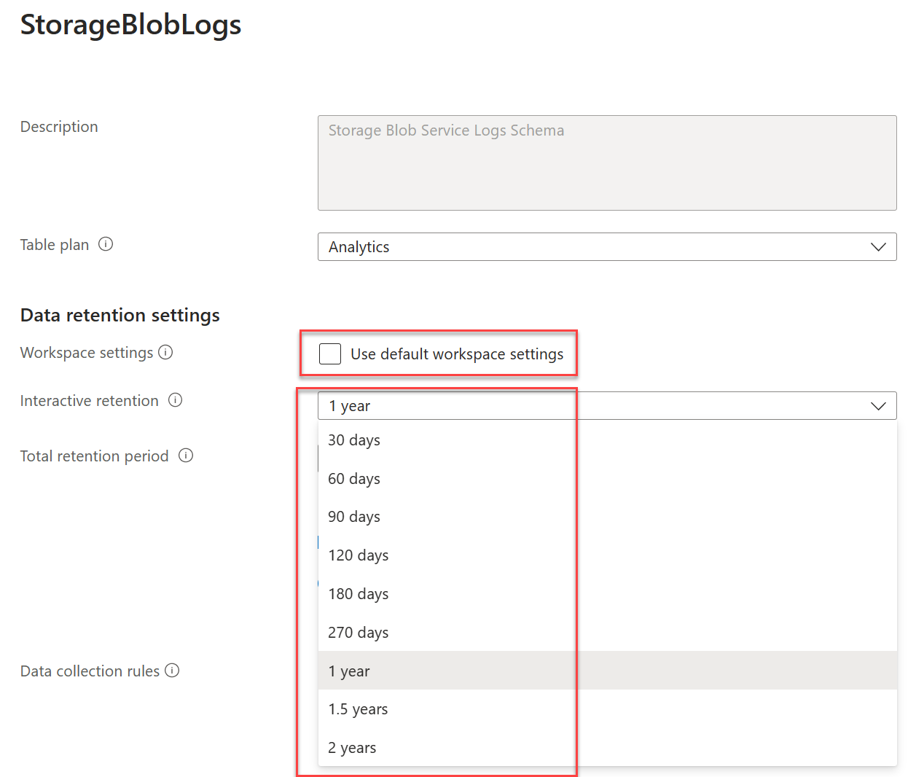
Set retention and archive policy by table
Tables in workspace inherit Log Analytics Workspace interactive settings by default.
Most tables can be changed to a different interactive retention setting
Exception is the legacy Free Trial pricing tier

Slide 28
Restoring logs in Azure Monitor
Restoring log data is done either through the Tables → Create or Update API or via the Azure CLI using az monitor log-analytics workspace table restore create command
Restore job makes a specific time range of data in a table available for high-performance queries
Restore jobs also allow you to execute very long-running queries (>10 minutes)
Search and Restore are both methods of accessing archived data:
  Use Search jobs when you are looking for something specific (e.g., SERVER001)
  Use Restore job if you need to perform in-depth queries of logs from a specific timeframe (e.g., firewall logs from January 1, 2023 – January 15, 2023)

Slide 29
DEMO:
Change the table plan from Analytics to Basic
Set interactive retention timeframe

Slide 30
Watchlists

Slide 31
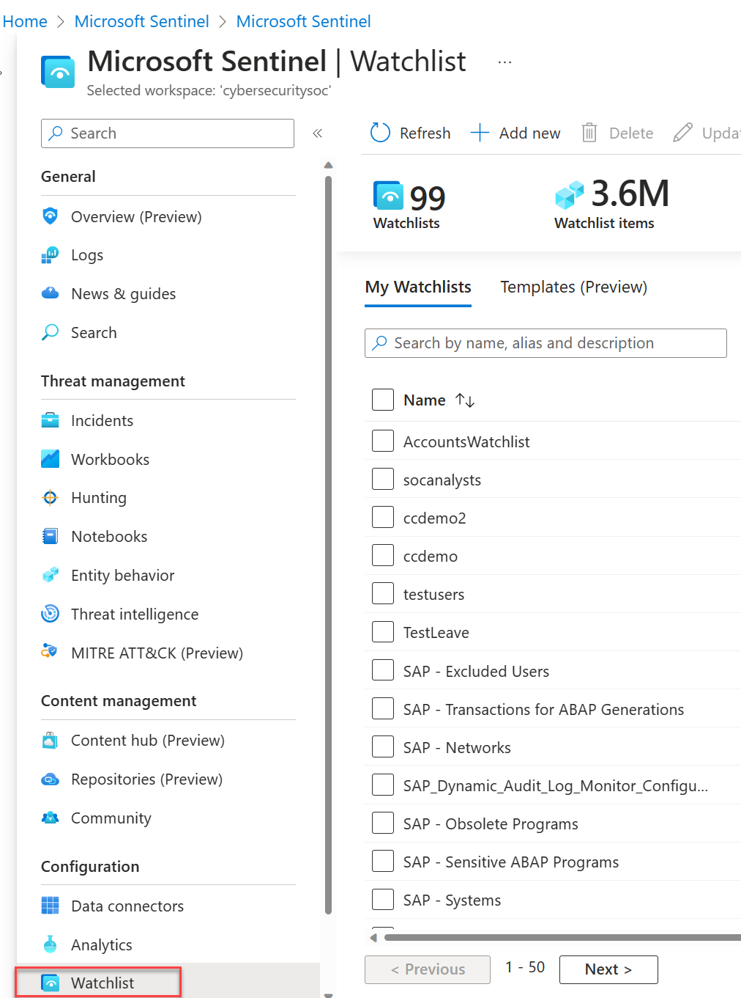
Use watchlists in Microsoft Sentinel
Watchlists allow you to correlate data from a data source you provide with events in Sentinel (e.g., terminated employees, high-value assets, service accounts, etc…)
Maximum number of watchlist items is 10 million; if you require larger data sets, ingest them using custom logs
Cross workspace and Lighthouse scenarios using watchlists are not supported; must be in same workspace where they are referenced (e.g., hunting queries)

Slide 32
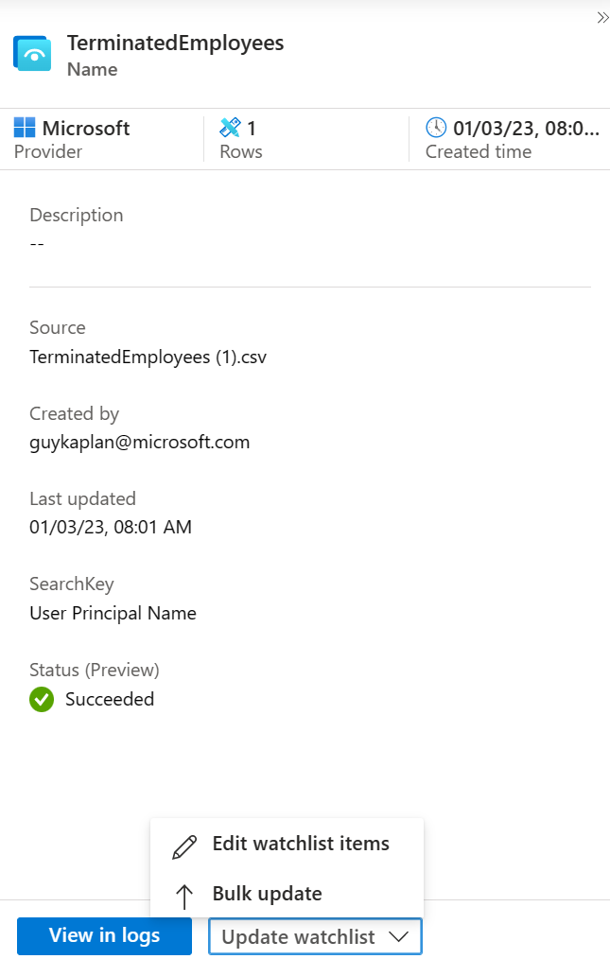
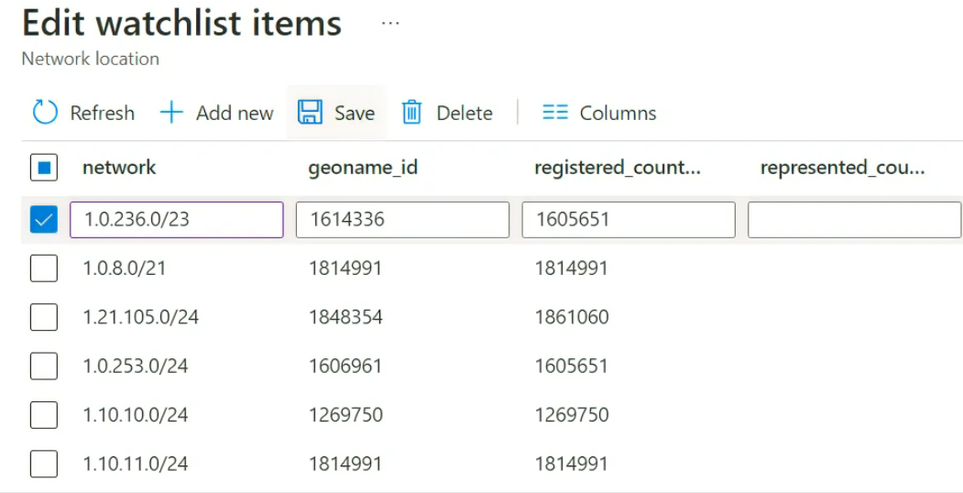
Updating watchlists in Sentinel
Leverage watchlist templates to standardize the data and make queries more efficient
Edit watchlists rather than deleting/recreating the watchlist.
Bulk update watchlist items using .csv file

Slide 33
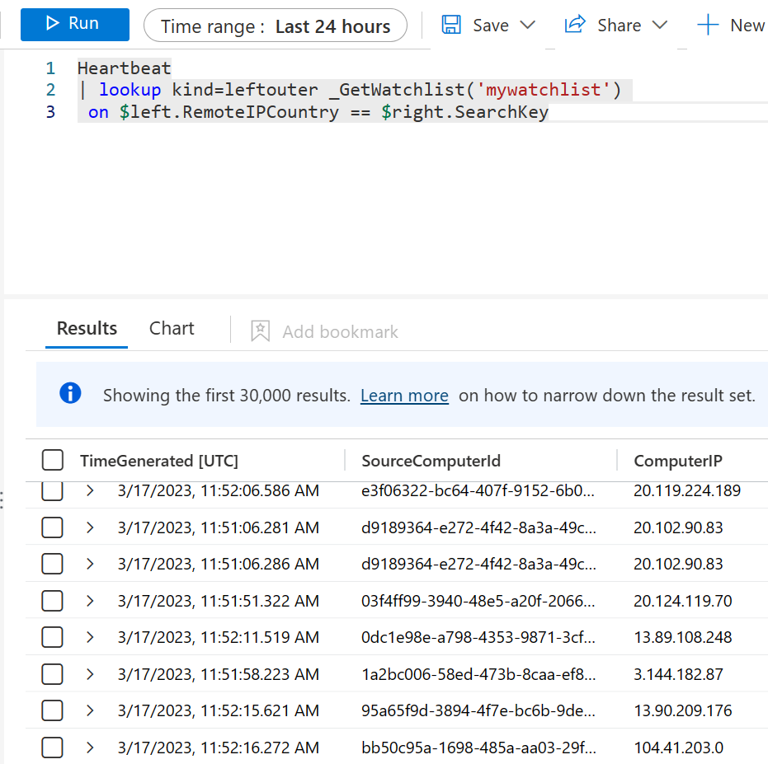
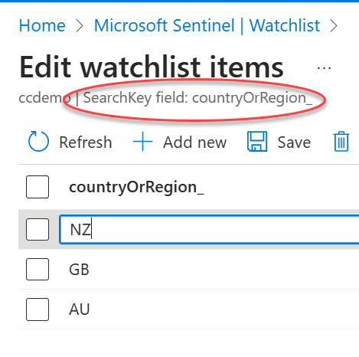
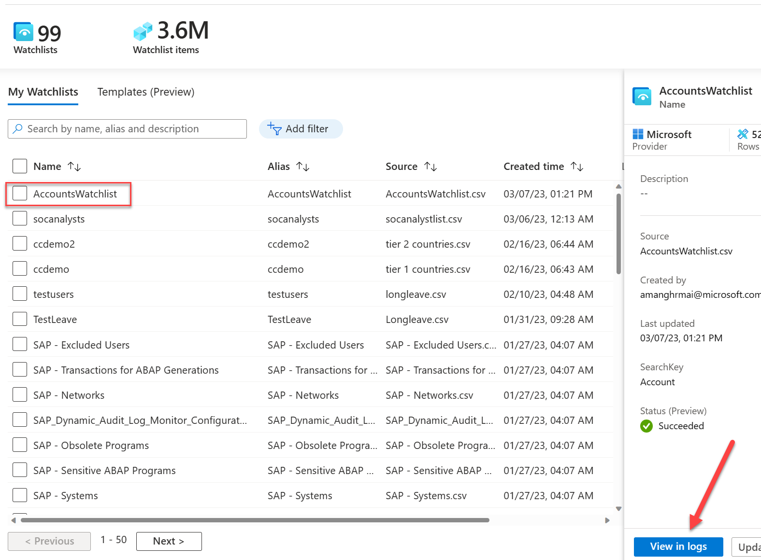
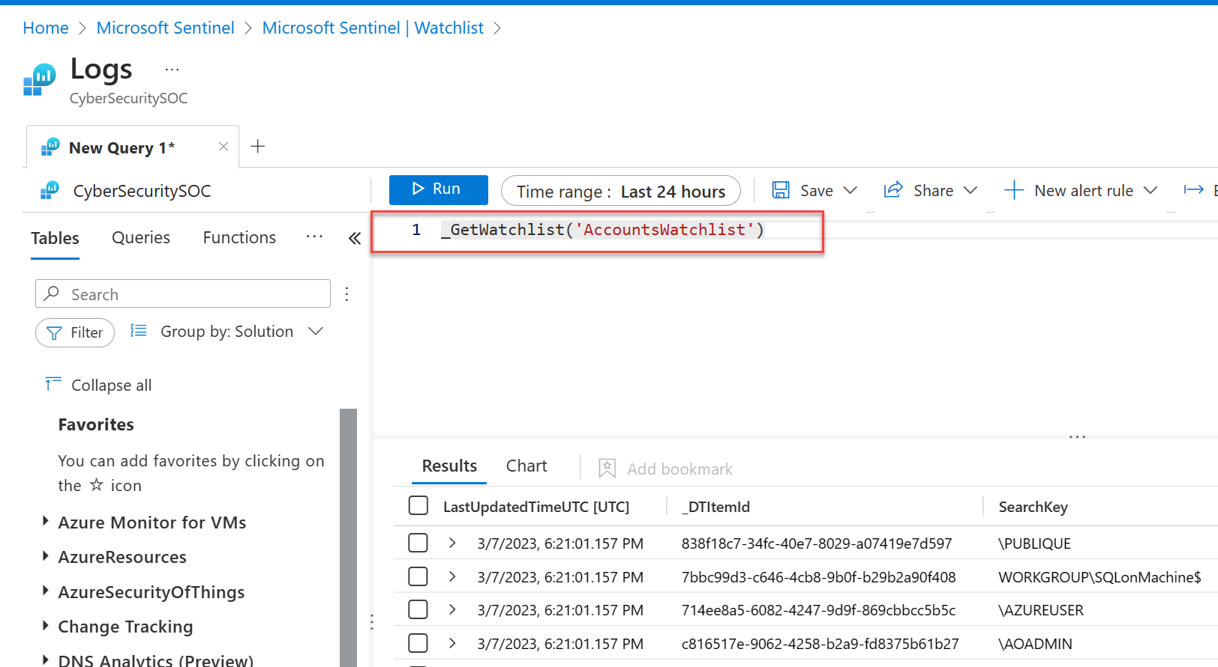
Build queries or detection rules with watchlists
Use _GetWatchlist in your query to incorporate the watchlist contents into your search
SearchKey is a column in the watchlist that you expect will be used frequently for searches (e.g., ComputerIP)
Use the KQL query as the foundation for creating detection rules.

Slide 34
Analytic Rules

Slide 35
Built-in analytic rule detection types
Rule type | Description
Microsoft security | Microsoft security templates automatically create Microsoft Sentinel incidents from the alerts generated in other Microsoft security solutions, in real time. You can use Microsoft security rules as a template to create new rules with similar logic.
Fusion | Uses scalable machine learning algorithms to detect advanced multistage attacks by correlating many low-fidelity alerts and events across multiple products into high-fidelity and actionable incidents.
Machine learning (ML) behavioral analytics | ML behavioral analytics templates are based on proprietary Microsoft machine learning algorithms, so you cannot see the internal logic of how they work and when they run.
Threat Intelligence | Leverage threat intelligence produced by Microsoft to generate high fidelity alerts and incidents with the Microsoft Threat Intelligence Analytics rule. When enabled, it will automatically match Common Event Format (CEF) logs, Syslog data or Windows DNS events with domain, IP and URL threat indicators from Microsoft Threat Intelligence.
Anomaly | Anomaly rule templates use machine learning to detect specific types of anomalous behavior. Each rule has its own unique parameters and thresholds, appropriate to the behavior being analyzed.
Scheduled | Scheduled analytics rules are based on built-in queries written by Microsoft security experts. You can see the query logic and make changes to it.
Near-real-time (NRT) (Preview) | NRT rules are limited set of scheduled rules, designed to run once every minute, in order to supply you with information as up-to-the-minute as possible.
Covered in upcoming session

Slide 36
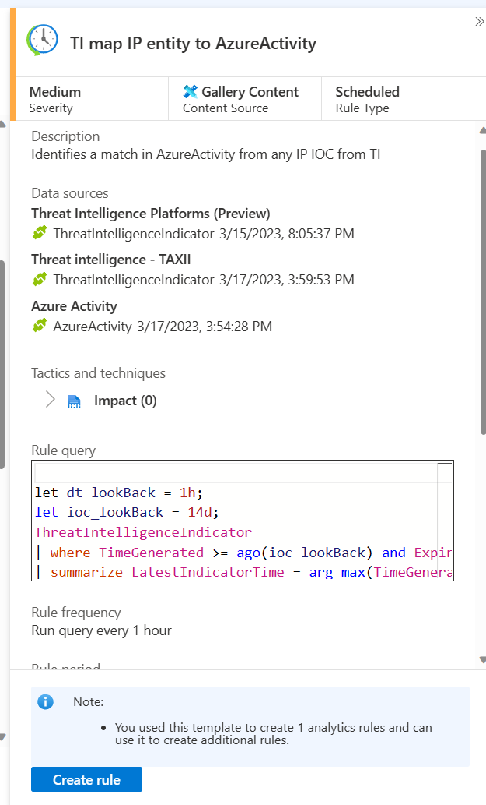
Detect threats using built-in analytics rules
Build a new analytics rule from scratch or create one from an existing template
Enable all rules associated with a connected data source
Where possible, preference for MSSP’s is to push rules to Sentinel via API or PowerShell rather than creating each one manually in each customer’s Sentinel workspace

Slide 37
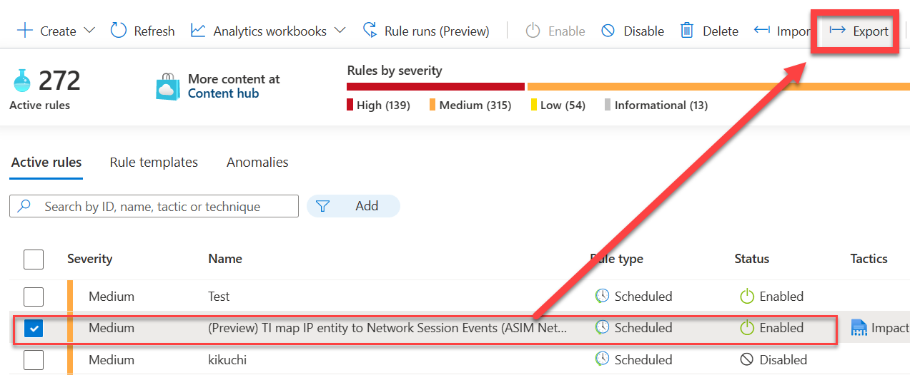
Export and import analytics rules
Export and import rules as ARM templates in JSON format
Rules can then be deployed to multiple instances of Sentinel
Allows for version control, updating and deployment via CI/CD framework

Slide 38
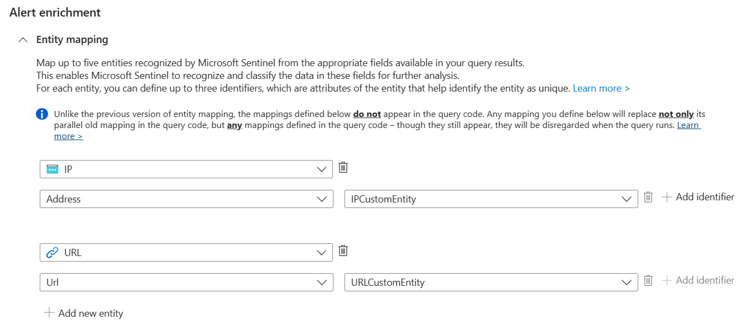
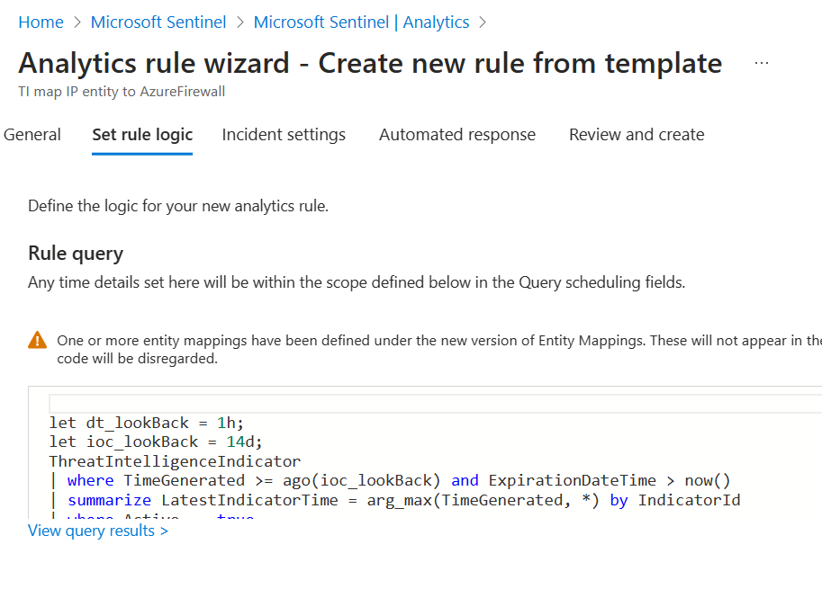
Create custom analytics rules
Start with existing rule as a template or reference
Build query using ASIM parser rather than a native table to future proof the query
Query cannot contain “search” or “union”; user-defined functions can be used, however.
Be sure to account for lookback period and ingestion latency

Slide 39
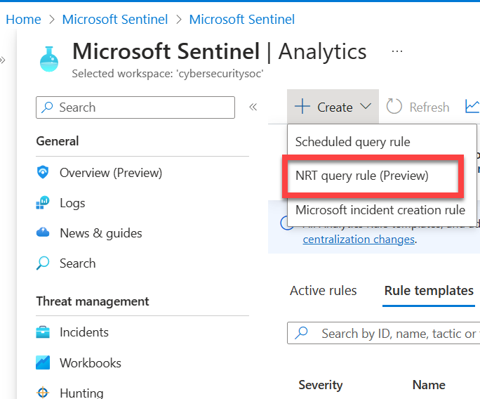
Near-Real-Time (NRT) detection analytics rules
Designed to run at 1-minute intervals; otherwise, the same as standard analytics rule
NRT’s do NOT allow for:
  Query scheduling
  Alert threshold
  Event groupings (limited to 30 events)
Limitations
  Maximum of 20 NRT’s
  Can refer to only a single table
  No joins or unions in query
  Cannot be run cross-workspace

Slide 40
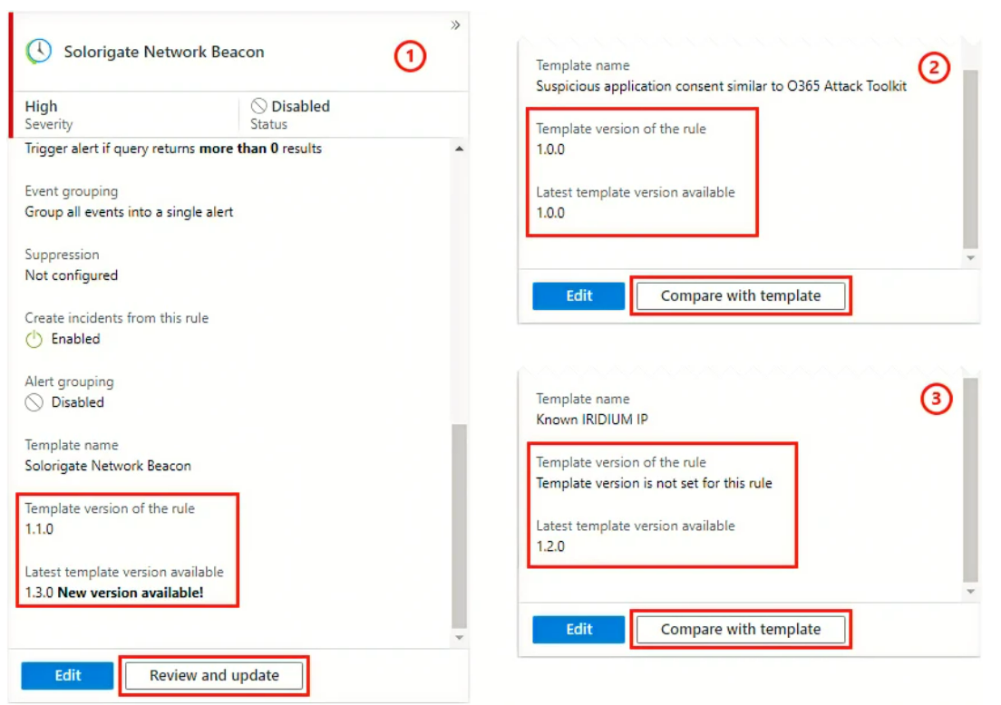
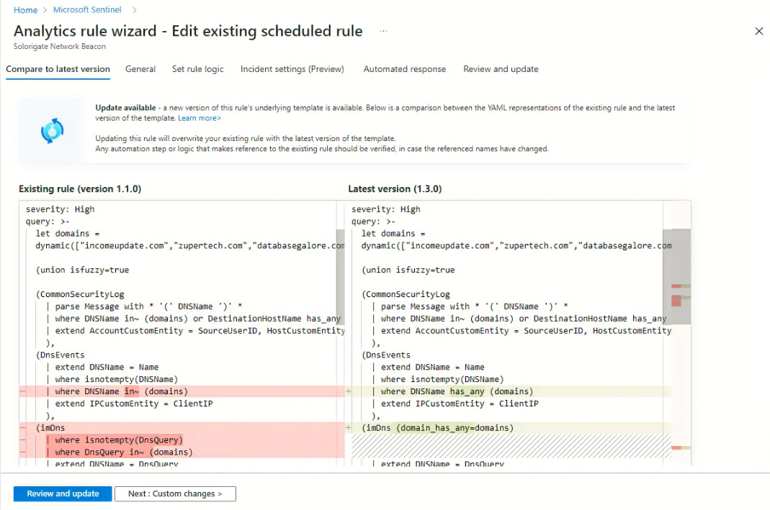
Manage template versions for scheduled analytics rules
If a rule is created by template, and the original template is updated, you should compare the update to the created rule.
Updating the rule will overwrite the template component of your existing rule
Automations and customizations to the original rule should be verified

Slide 41
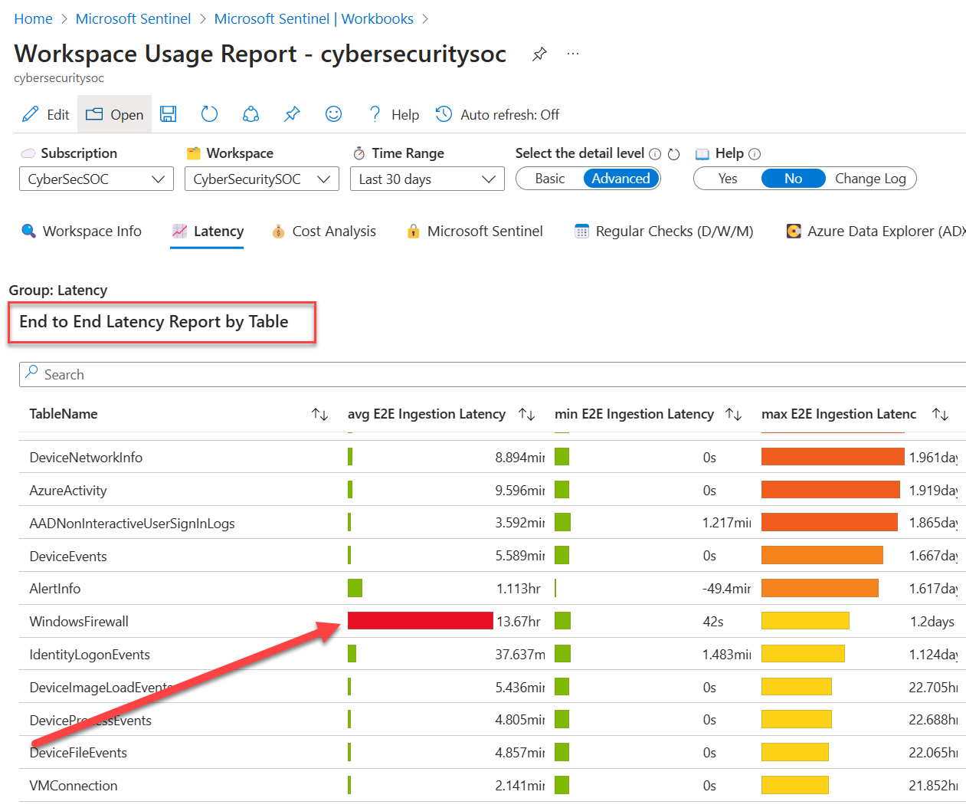
Handling ingestion delay and rules
Ingestion delay can result in missed alerts if lookback time is not factored properly.
Correcting the issue requires you to know the delay for your data type
Gather ingestion delay information from Advanced section of the Workspace Usage Report → End to End Latency Report by Table

Slide 42
DEMO
Workspace Usage Report

Slide 43
Thank you

